Slide 1
AWS
Agenda Day-03:
IAM
Users, Roles, Group
IAM policies
Intro to Serverless framework
AWS Lambda

Slide 2
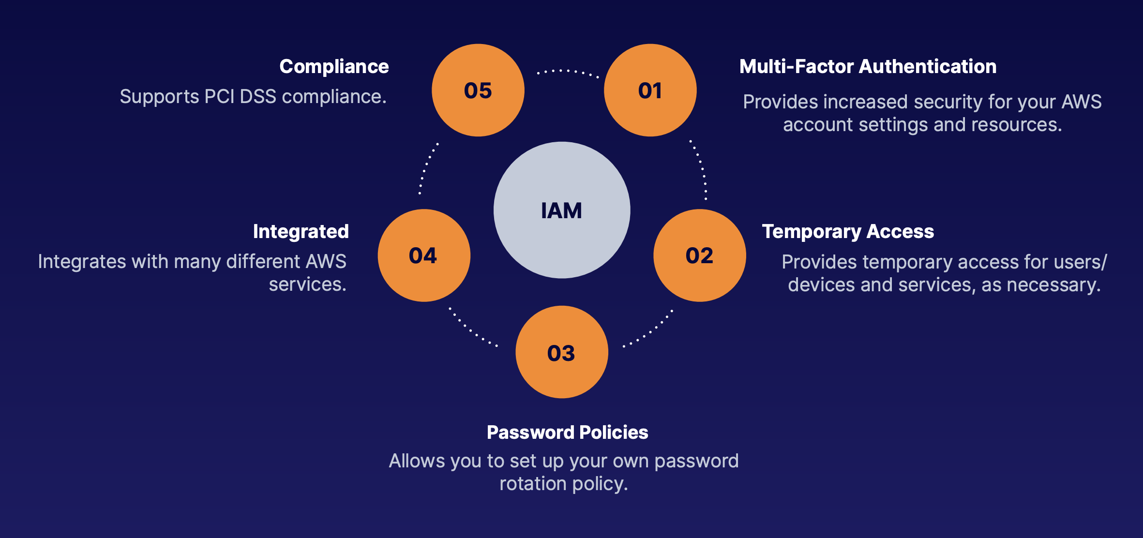
IAM Basics
IAM stands for Identity Access Management. It is Global, you do not specify a region when dealing with IAM. When you create a user or group, this is created GLOBALLY.

Slide 3
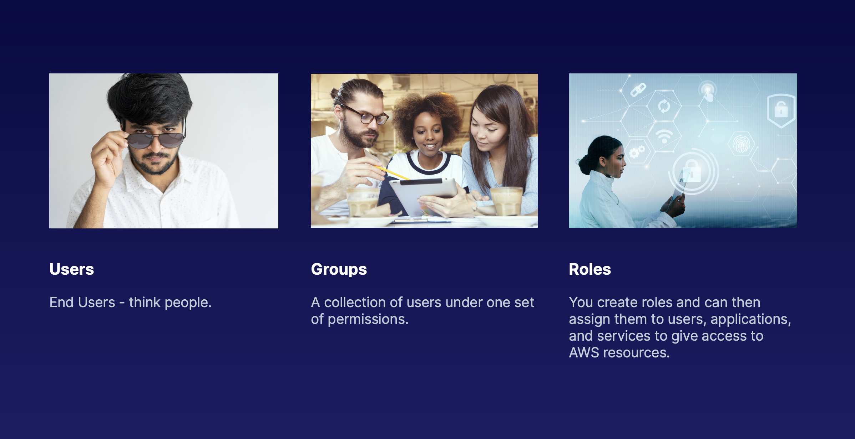
Users, Groups, and Roles
You can access the AWS platform in 3 ways:
AWS Console
Programmatically (Using the Command Line)
Using the Software Developers Kit (SDK)
IAM POLICY :
A document that defines one or more permissions.
An IAM policy can be attached to a user, group or role.
JSON Format

Slide 4
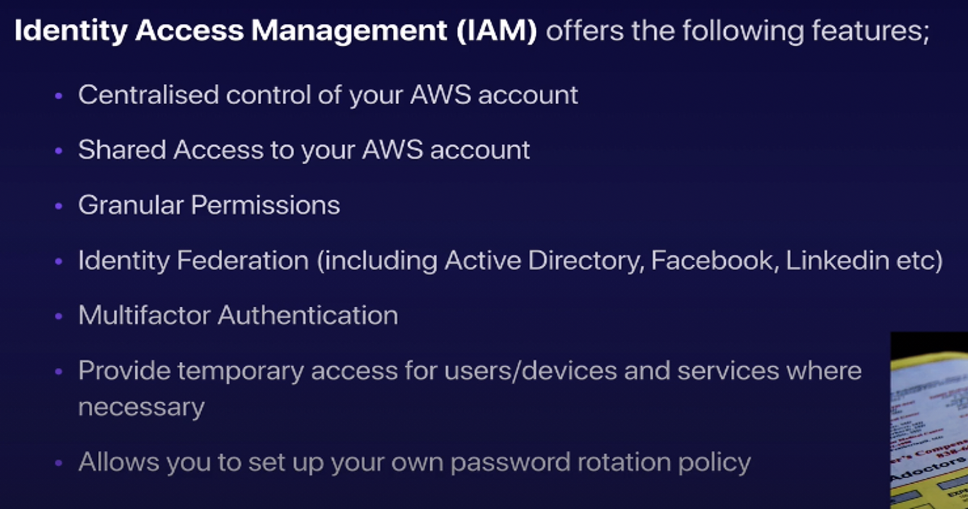

Slide 5
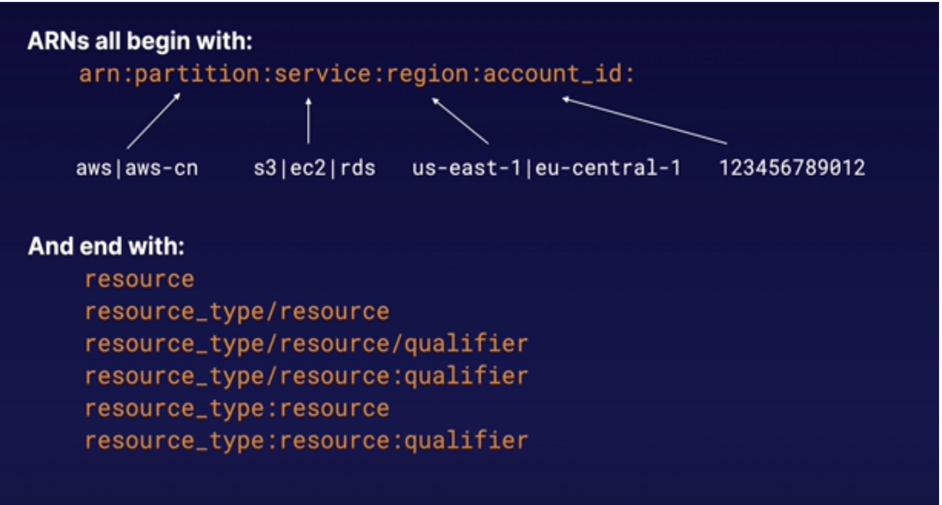

Slide 6
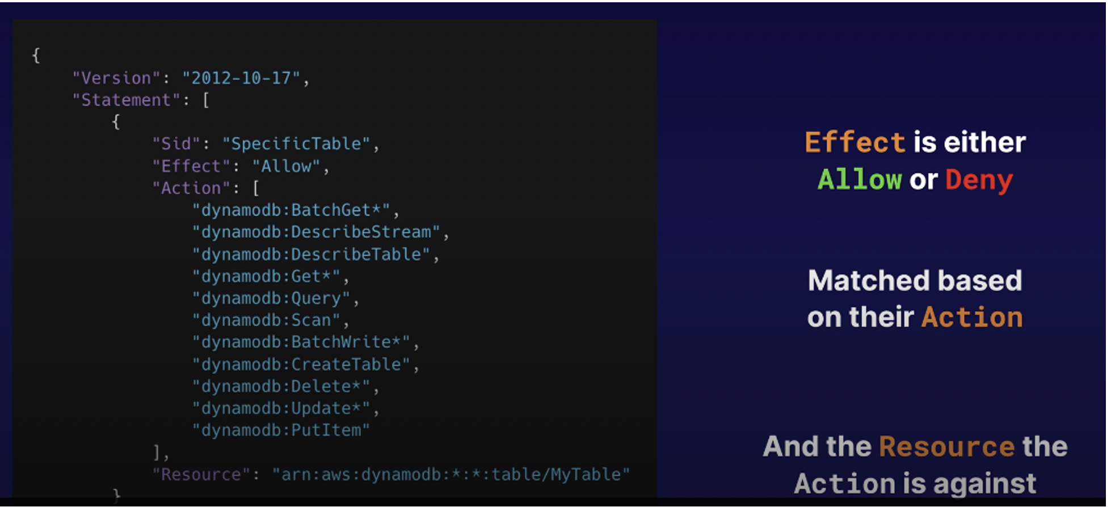

Slide 7
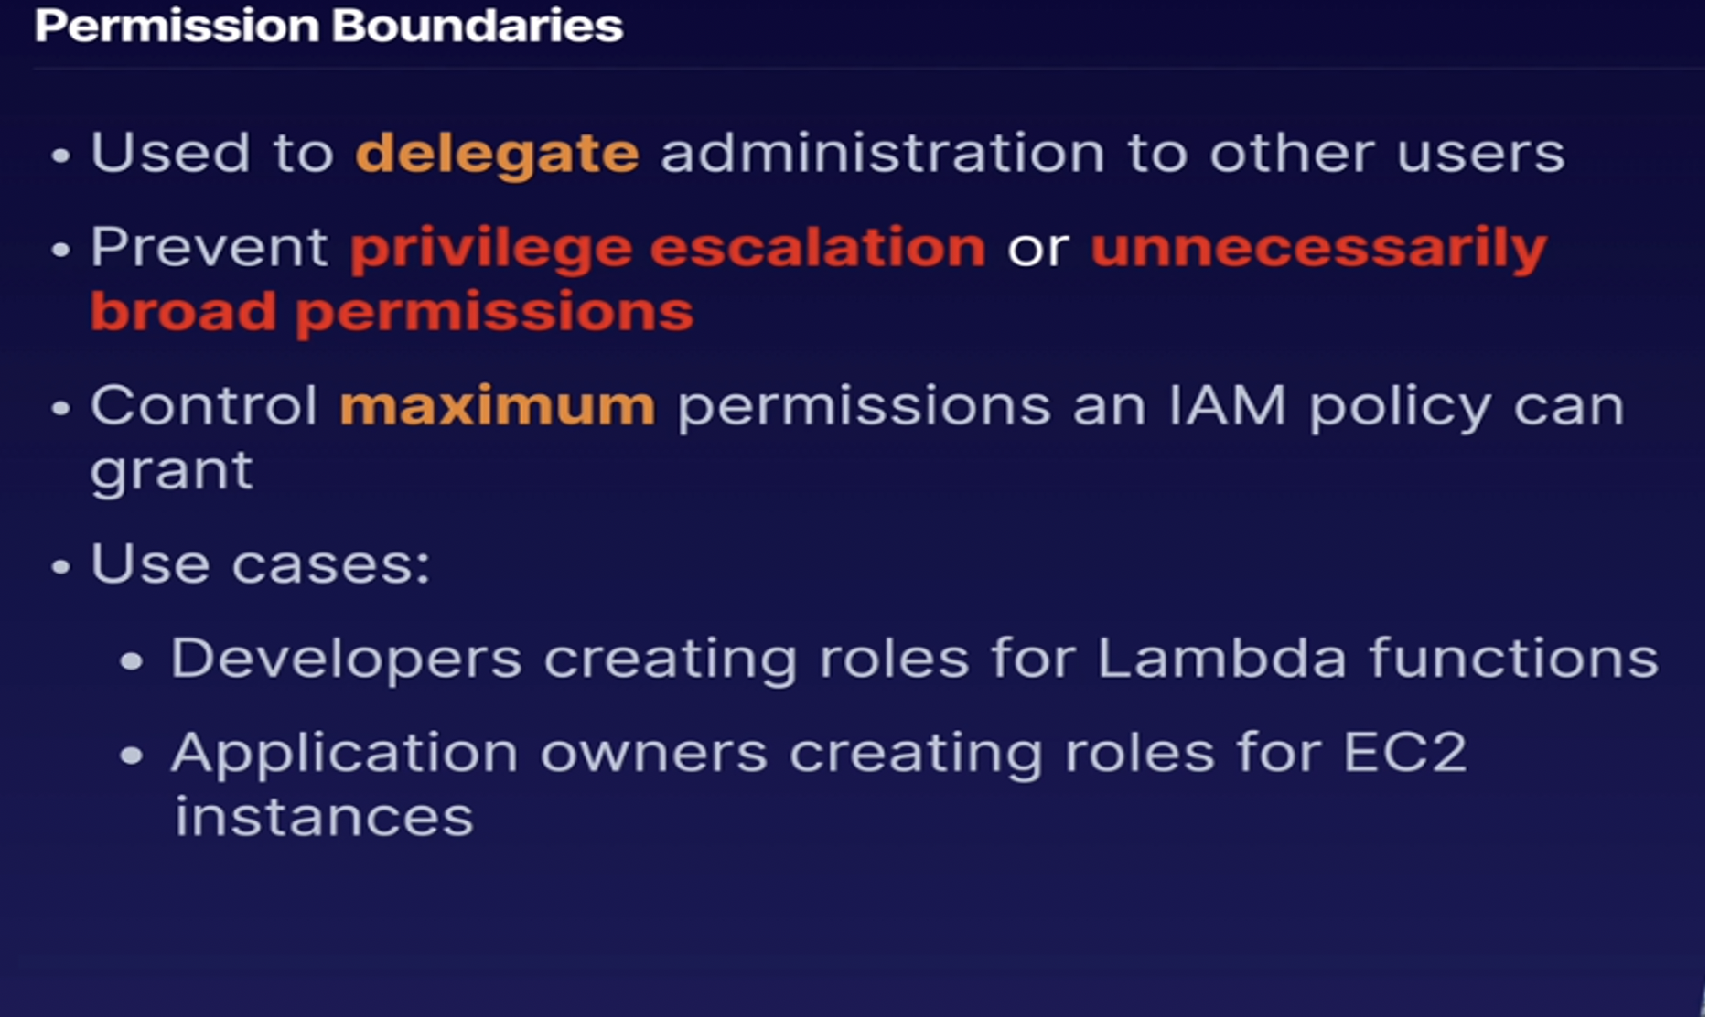

Slide 8



LAMBDA
Serverless compute
Run your code in AWS without provisioning any servers. Lambda takes care of everything required to run your code, including the runtime environment.
Supported Language
Java, Go, PowerShell, Node.js, C#, Python, and Ruby. Upload your code to Lambda and you are good to go!
Enterprise Features
Auto-scaling and high availability are already baked-in to the Lambda service.

Slide 9
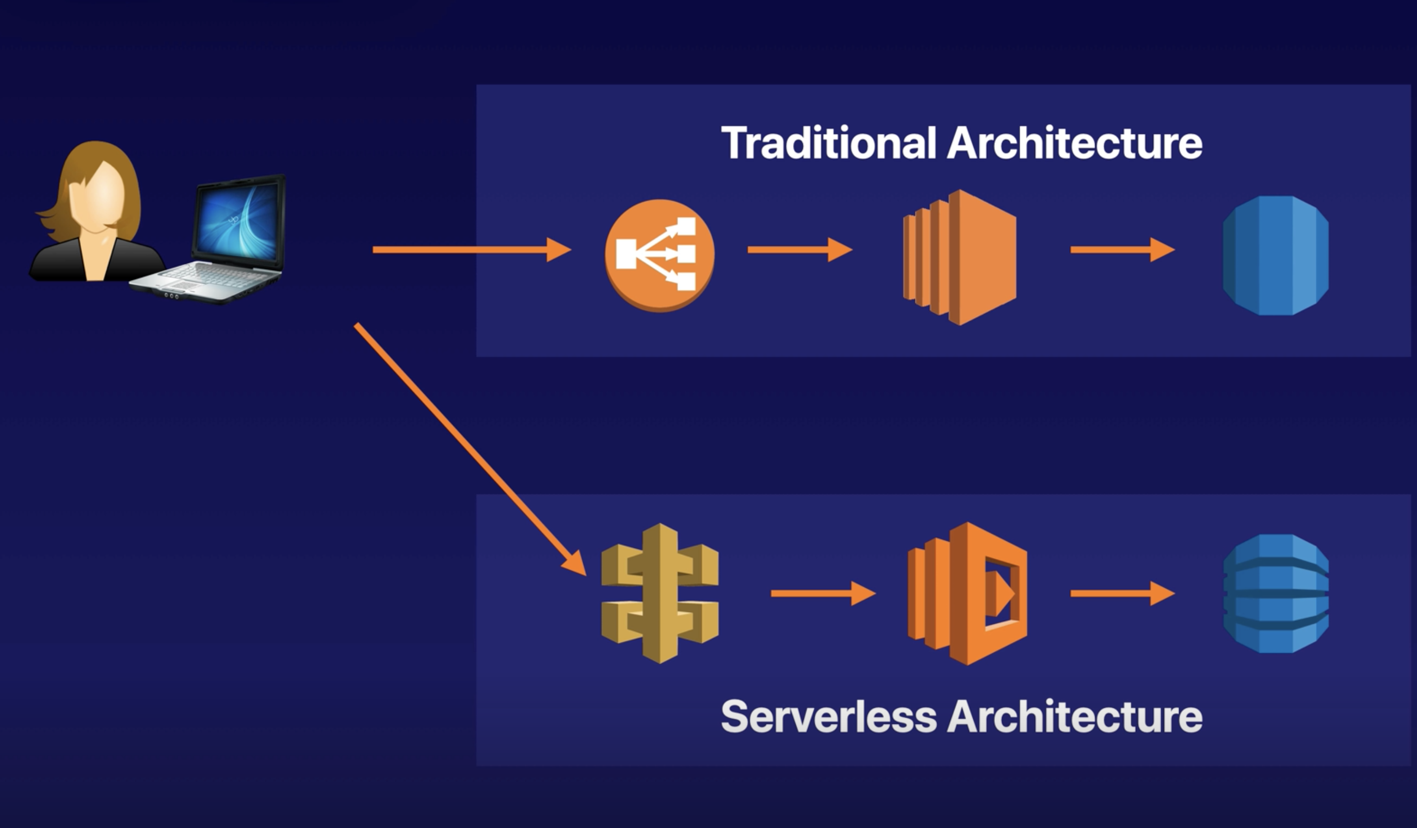
Basic Architecture

Slide 10
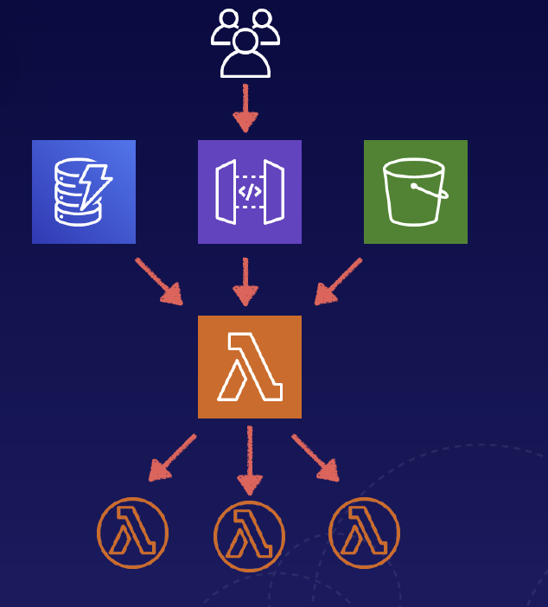
Event-Driven Architecture
Lambda functions can be automatically triggered by other AWS services or called directly from any web or mobile app
Triggered by Events
These events could be changes made to data in an S3 bucket, or DynamoDB table.
Triggered by User Requests
You can use API Gateway to configure an HTTP endpoint allowing you to trigger your function at any time using an HTTP request.

Slide 11
Key Points to remembered:
You are charged based the number of requests, their duration, and the amount of memory used by your Lambda function.
Lambda scales out(not up) automatically
Lambda functions are independent (1 event = 1 function)
You can have multiple versions of your code inside lambda
You are responsible for your code. Amazon is responsible for the hardware, os, security patching, antivirus, etc..
Requests
The first 1 million requests per month are free.
$0.20 per month per 1 million requests.
Duration
You are charged in 1 millisecond increments.
The price depends on the amount of memory you allocate to your Lambda function.
Price per GB-second
$0.00001667 per GB-second.
A function that uses 512MB and runs for 100ms.
0.5GB X 0.1s = 0.05 GB-seconds. $0.0000000083
The first 400,000 GB-seconds per month are free.

Slide 12
Hands-on lab
How to create an IAM user?
How to attach the role to IAM users?
How to write an IAM policy using a policy generator ?
How to run lambda functions

